Slide 1
Geographic Basics for Air Quality Monitoring and Mapping
Amra Banda
University of Sarajevo – Faculty of Science
Department of Geography

Slide 2
Air Quality Data Are Spatial Data
WHAT?
PM₂.₅, PM₁₀, NO₂, O₃...
WHERE?
Latitude
Longitude
Elevation
WHEN?
Date
Time
Duration
A measurement without spatial and temporal context tells only part of the story.

Slide 3
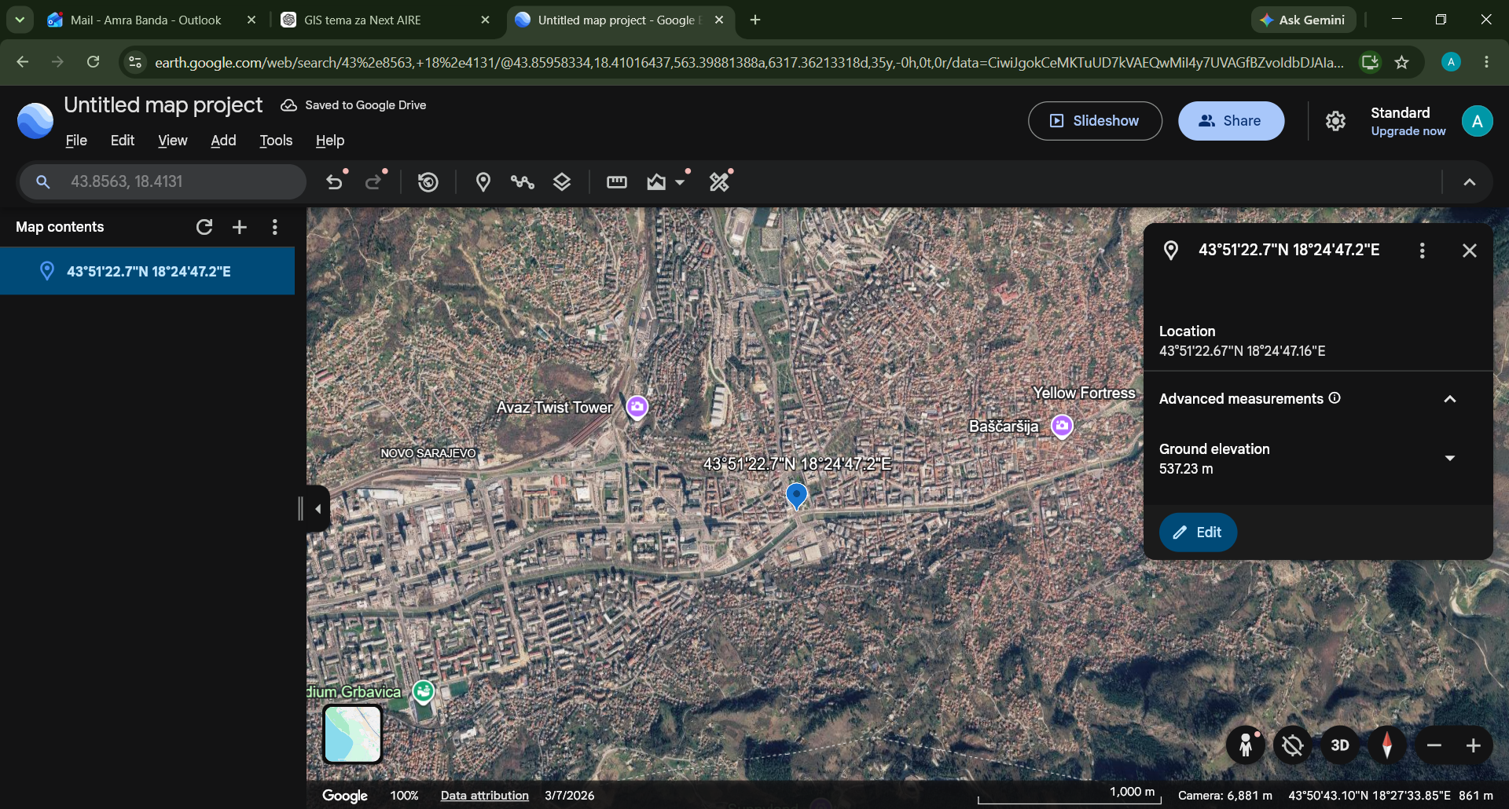
From coordinates to location
Example location: Sarajevo
Geographic coordinates
Latitude: 43.8563° N
Longitude: 18.4131° E
Elevation: 537 m
Coordinate Reference System (CRS)defines how coordinates relate to locations on the Earth
WGS 84 is commonly used for GPS-based geographic coordinates
Coordinates + reference system → geographic location
Google Earth displays the same location in degrees, minutes and seconds (DMS).

Slide 4
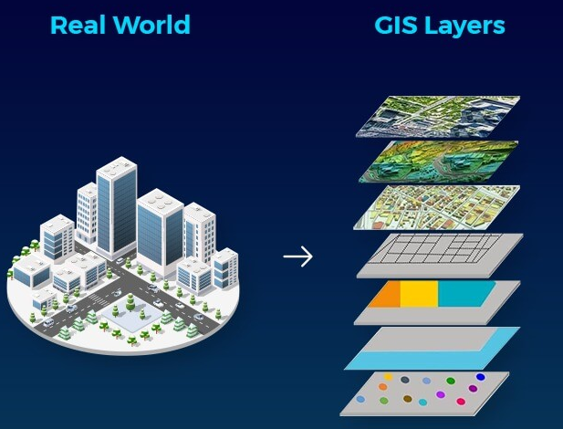
Putting a Monitoring Site into Spatial Context
📍 Points
🗻 Raster
Monitoring stations,
emission sources
Elevation, satellite imagery,
▰ Polygons
━━ Lines
Land use, administrative areas
Rivers, roads
GIS integrates different spatial layers to provide context for monitoring locations.

Slide 5
What Does a Monitoring Station Represent?
AREA TYPE
Urban
Suburban
Rural
Source: European Environment Agency
DOMINANT INFLUENCE / STATION TYPE
Traffic
Industrial
Background (not dominated by a single nearby source)*
A background station is intended to represent wider-area exposure rather than the influence of a single dominant source.
*Background stations can be urban, suburban or rural.

Slide 6
📍 MONITORING SITE
Land use
Emission sources
Road network
Buildings / urban form
Topography
Elevation
Meteorological conditions
Population
What area does this measurement actually represent?
Sources: European Commission; Righini et al., 2014

Slide 7
MONITORING OBJECTIVE
MONITORING OBJECTIVE SELECTION CRITERIA SUITABLE LOCATION
Population exposure?
Traffic pollution?
Industrial influence?
Regional background?
Urban background?
The best monitoring location depends on what we want the measurement to represent.
Sources: European Commission; Righini et al., 2014

Slide 8
GIS Tools for Air Quality Monitoring
BEFORE MONITORING
Explore potential sites
Distance from roads/sources
Examine land use
Population distribution
Elevation/topography
Existing monitoring network
AFTER MONITORING
Map monitoring sites
Combine measurements with spatial data
Explore spatial patterns
Produce maps
Support interpretation and communication
GIS CAN ALSO HELP IDENTIFY
Spatial gaps in the monitoring network
Clustering of monitoring stations
Underrepresented environments
Highly populated areas with
limited monitoring
Potential locations for network expansion
QGIS • ArcGIS / ArcGIS Online • Google Earth • OpenStreetMap • Copernicus

Slide 9
GIS-Based Assessment of Spatial Representativeness
Spatial variability of emissions can be used as a proxy for the spatial representativeness of monitoring sites.
Emission inventory data - Spatial variability around monitoring sites - GIS-based representativeness assessment - Representative area of each monitoring site (Righini et al., 2014)
Lower spatial variability→ more homogeneous emission environment→ potentially larger representative area
Higher spatial variability→ heterogeneous emission environment→ potentially smaller representative area
GIS provides the geographical context. Integrated thematic layers can include: road network, urban areas, major emission sources, CORINE Land Cover, Digital Terrain Model

Slide 10
Different approaches to spatial representativeness
There is no single universally accepted method for defining spatial representativeness.
Different methods, same question - how large is the area for which a monitoring site can be considered representative?
Land-use characteristics - Janssen et al., 2012
Land-use characteristics of the surrounding area
Emission variability - Righini et al., 2014
Spatial variability of emissions around monitoring sites
Modelled concentration similarity - Piersanti et al., 2015
Similarity of concentration patterns around a monitoring site
Geostatistical approaches - JRC / FAIRMODE
Spatial correlation and variability of air-quality data

Slide 11
From Representativeness to Network Optimization
Why assess spatial representativeness?
Monitoring-site representativeness - Compare representative areas - Assess overlap and spatial gaps - Optimize the monitoring network
Identify redundant monitoring sites
Detect areas insufficiently represented
Support hotspot monitoring
Improve population-exposure assessment
Support model validation and data assimilation
Network quality depends on the spatial information provided by its stations, not simply on station density.

Slide 12
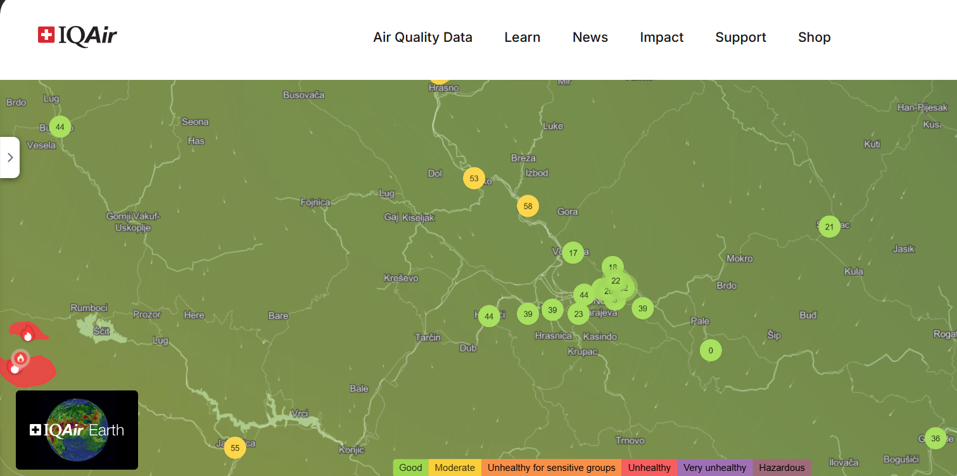
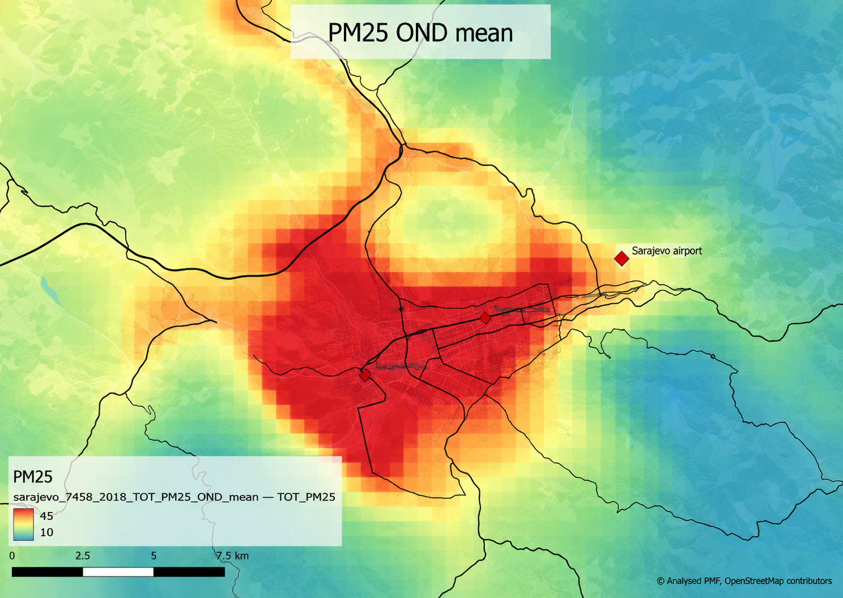
From Monitoring Points to Air Quality Maps
Continuous air-quality maps may combine ground observations with spatial, meteorological, emission and Earth Observation data.
GROUND-BASED OBSERVATIONS
Measurements at discrete locations
CONTINUOUS SPATIAL INFORMATION
Estimated or modelled values across space
INTERPOLATION /
MODELLING

Slide 13
Interpolation
Results depend on:
Number and spatial distribution of monitoring sites
Spatial variability of the pollutant
Interpolation / modelling method
Topography and land use
Meteorological conditions
Validation
Common approaches: IDW • Kriging • regression-based / spatiotemporal approaches
A visually detailed map does not necessarily mean that equally detailed observations are available.
Spatial resolution should reflect the density, distribution and quality of the underlying data.

Slide 14
IDW vs. Kriging - Basic Comparison
IDW – Inverse Distance Weighting
closer observations
have greater influence
simple and intuitive
strongly affected by the distribution of monitoring points
Kriging
uses spatial autocorrelation
considers the spatial structure of the data
can provide information about prediction uncertainty
There is no universally “best” interpolation method, the choice should depend on the data and validation.

Slide 15
Geographic Basics for Better Air Quality Monitoring
Location matters.
The monitoring objective comes first.
A station must be understood in its spatial context.
GIS connects measurements with their environment.
Measured values and mapped estimates are not the same.
Good maps require critical spatial thinking.
Good air-quality monitoring requires not only good measurements, but also good spatial thinking.

Slide 16
Thank you!

Slide 17
References
European Environment Agency (EEA). Air quality monitoring station classifications and criteria. European Environment Agency.
European Commission / Joint Research Centre (JRC). FAIRMODE work on the spatial representativeness of air quality monitoring stations.
Janssen, S., Dumont, G., Fierens, F. & Mensink, C. (2012). Spatial interpolation of air pollution measurements using CORINE land cover data. Atmospheric Environment, 52, 306–310.
Righini, G., Cappelletti, A., Ciucci, A., Cremona, G., Piersanti, A., Vitali, L. & Ciancarella, L. (2014). GIS based assessment of the spatial representativeness of air quality monitoring stations using pollutant emissions data. Atmospheric Environment, 97, 121–129.
Piersanti, A., Vitali, L., Righini, G., Cremona, G. & Ciancarella, L. (2015). Spatial representativeness of air quality monitoring stations: A grid model based approach. Atmospheric Pollution Research, 6(6), 953–960.
Joint Research Centre (JRC) / FAIRMODE. Assessment of spatial representativeness of air quality monitoring stations — intercomparison and methodological work.
European Space Agency (ESA) / Global Development Assistance. Earth Observation-based Air Quality and Traffic Monitoring in Sarajevo.
Swedish Meteorological and Hydrological Institute (SMHI). Improvement of Air Quality and Air Quality Management in Bosnia and Herzegovina – IMPAQ.

Slide 18
References
Figures
Google Earth
https://trackobit.com/wp-content/uploads/2024/07/GIS-Layers.jpeg
https://www.iqair.com/eu/air-quality-map
https://gda.esa.int/story/earth-observation-based-air-quality-and-traffic-monitoring-in-sarajevo/

